Slide 1
Marketing Cloud Pilot Program
Project Update

Slide 2
Project Timeline
Project Kickoff
Began engagement with 3rd party implementation partner, Offprem
Marketing Cloud Configuration
ᐧ Offprem to configure data model
ᐧ Configure subdomain
ᐧ Configure user roles and permissions
ᐧ Set up basic workflows
Governance Planning
ᐧ Meet with Office of the Provost and of the President to
align workflows with existing approval processes for
mass emails
AUG 2023
FEB 2024
APR 2024
JUL 2023
DEC 2023
MAR 2024
Requirements Gathering
ᐧ Identified users
ᐧ Defined roles and responsibilities
ᐧ Identified target audiences
ᐧ Met with data owners for HR & Student data
ᐧ Confirmed data elements to be shared
NEXT: Work w/ CUIT EBIS to automate data sharing
User Training
ᐧ Public Affairs users will be trained to use and
support the Marketing Cloud application
Ready for Launch
ᐧ Actual go-live date will be
determined based on
communication needs during that
time of year

Slide 3
Why We Need Marketing Cloud
Current State
Negative Effects
Lack of Coordination - No ability to control timing or sequencing of messages; no data-sharing
Message Oversaturation - Some audiences are spammed, others neglected
Disaggregated Data - Pockets of data wealth coupled with vast data deserts
Inadequate Software - Multiple solutions, most of them inadequate, none serving University as a whole
Vulnerable During a Crisis - Lack of agility in emergencies leaves us open to communication failure
Negative Audience Experience - Leads to decreased engagement; missed research funding opportunities
Confusion in Crisis Communications - Mixed, uncoordinated messaging; duplication of effort; poor timing
Legal Implications - Inconsistent compliance with CAN-SPAM, GDPR, CCPA, etc., in collecting user data
Unsustainable - Columbia can’t continue to stand up multiple redundant or inadequate systems in isolation, paying implementation costs for the same work for each installation
Notes:
According to an internal survey done right before the pandemic, groups are using several different tools, none of which share data or even collect the same data. This makes it nearly impossible to build and maintain the kind of user data that is the key to our most effective audience engagement. The lack of data also means communicators have little idea whether they are reaching intended audiences or how to engage them. The absence of these things is diminishing Columbia’s ability to maximize enrollment, fundraising, research grants, patient care, and emergency and crisis-related messaging to internal and external audiences. Next slide, please.

Slide 4
What We Gain With Data-sharing
Email internal and external subscribers en masse
Integrate with Universitywide technology platforms
Create personalized experiences for audiences
Customize data capture, aggregation, and reporting
Share audience data across all University accounts
Provide enhanced features and services for all users
Build internal data and communications expertise to share
Coordinate and pause, when necessary, participants’ communications
Notes:
Keith has already laid out some of the most important benefits of Marketing Cloud. In short, a shared Marketing Cloud instance will give us a lean, controlled, accountable platform for communicating news, research, events, and emergency messaging to internal and external audiences. We have spent the past few years creating a University-wide communications network at the editorial, design, and crisis management levels, and created a real culture of collaboration and innovation. What we lack are technological tools that allow us to work together at a deeper level, learn from each other, and create seamless experiences for our audiences. Sioled data, in the context of an institution like columbia, is inherently not good data. Next slide, please.

Slide 5
Governance
An agreed-upon set of policies and rules will lie at the heart of this collaboration.
A governance committee of representatives from central administration and participating teams will enforce the policies.
Regular meetings and reports will help streamline operational decisions and deal with outlier situations.
Notes:
We’ve taken a great deal of care in making sure that we are in compliance with all CUIT and university policies on data security. We are working with the Enterprise Business Intelligence Solutions team in CUIT to make sure we follow best practices in data modeling and data management. Along with all the shared resources and benefits, it will also be possible to customize and segment data for security and other reasons. Colleen will explain our data model.

Slide 6
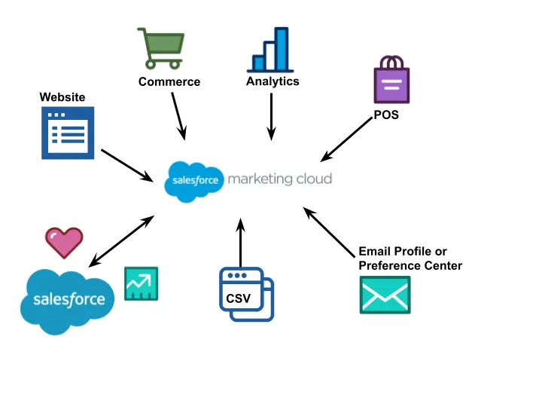
Data Model

Slide 7
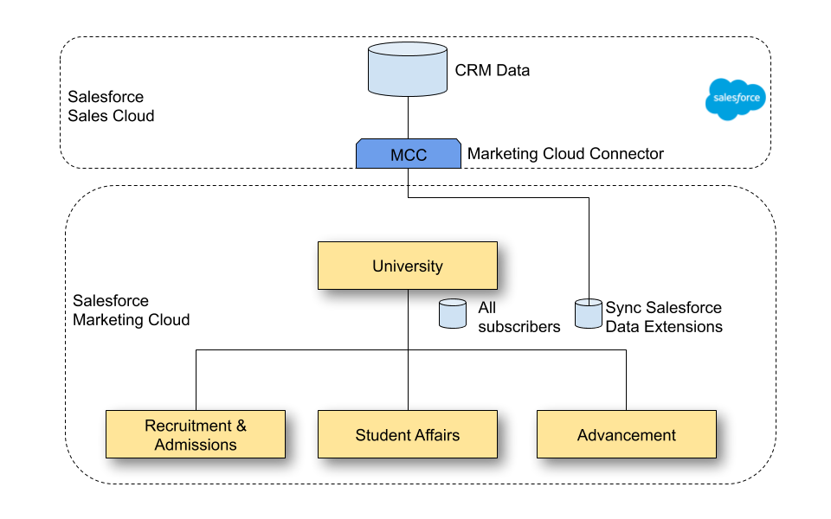
Data Model

Slide 8
Security
Uses business units in hierarchies for sharing (optional) and security
Can be as open or restricted as you want:
All Data
Certain Types of Data
Individual Data Points
Limit Interactions
Visibility
Deletion
Edit Functionality
Send Functionality
Integration into Other Systems
Who sees and controls what?
What comes in?
Access and Security will rely on existing data security standards

Slide 9
How Can You Join?
Central Administrative Offices
Talk to us ASAP!
We’d love to hear about your needs and see if the central University Marketing Cloud platform would be a good fit for you
Non-Central Administrative Offices
Please reach out too!
While this platform was designed with Central Administrative Offices and audiences in mind, we’d love to understand your use cases to see what might be possible in the future

Slide 10
When Can You Join?
Groups that require little to no customization and that communicate with audiences that we already gather data about may be eligible to join as early as Summer 2024
Groups with more complex workflow, data, and/or integration needs may need to engage with their own implementation partner in order to get started

Slide 11
Cost Estimates
Costs will vary based on your specific use cases, but the following criteria will be used to determine your individual cost requirements:
# of licensed users
Volume of messages sent per year
Need for integrations and/or customization within Marketing Cloud

Slide 12
Cost Estimates - Examples
Small Team - $4,000 to $8,000 per year
1-3 licensed users
50,000-250,000 messages per year
No new integrations or customizations
Large Team - $25,000/year + $165,000/one time for implementation partner
10 licensed users
15M messages per year
Additional costs possible for integrations and custom development w/in Marketing Cloud

Slide 13
Questions?

